Slide 1
Deconstructing Docker for Safety-Critical Applications Scott Mills
Andrei Juc

Slide 2
Agenda

Slide 3

What is covered in this tutorial?
About us and Rogue Wave Software
About Docker
Installing Docker
Downloading images
Running containers
Use commands and parameters
Container and image management
Using a registry
Gotchas, tips and tricks
Notes:
Honeywell

Slide 4

What will you take away from this session?
What is Docker?
How to install Docker and download images
Provision your images
Docker tools and run-time parameters
Docker registry management
Miscellaneous Tips
Potential pitfalls & limitations
Your own Docker Jenkins instance!
Notes:
Honeywell

Slide 5
About us

Slide 6




Ottawa, ON
Las Vegas, NV
Notes:
Honeywell

Slide 7
Scott Mills
Technical background
Almost 20 years designing, developing, maintain and supporting automation systems
Application performance testing
Application security testing (OWASP Top 10)
Automated web testing
Build & test automation framework development and evolution utilizing Python, Jenkins, Docker and Amazon Web Services
Notes:
Honeywell

Slide 8


Scott Mills
While not automating…
Notes:
Honeywell

Slide 9
Andrei Juc
Technical background
Automation framework developer
VM to Docker migration
Amazon Web Services migration
Troubleshooting enthusiast
Innovator
Notes:
Honeywell

Slide 10
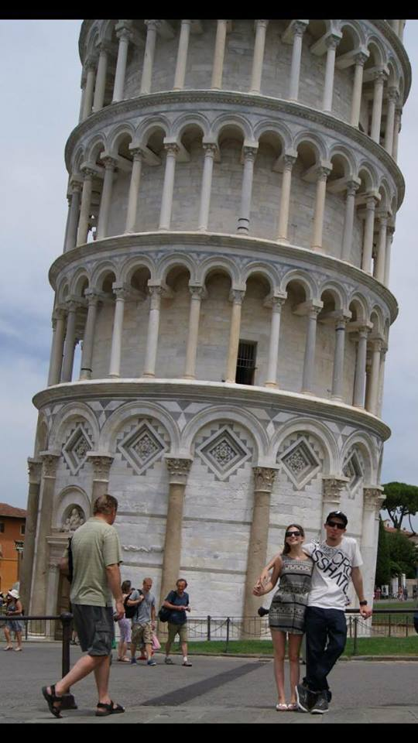
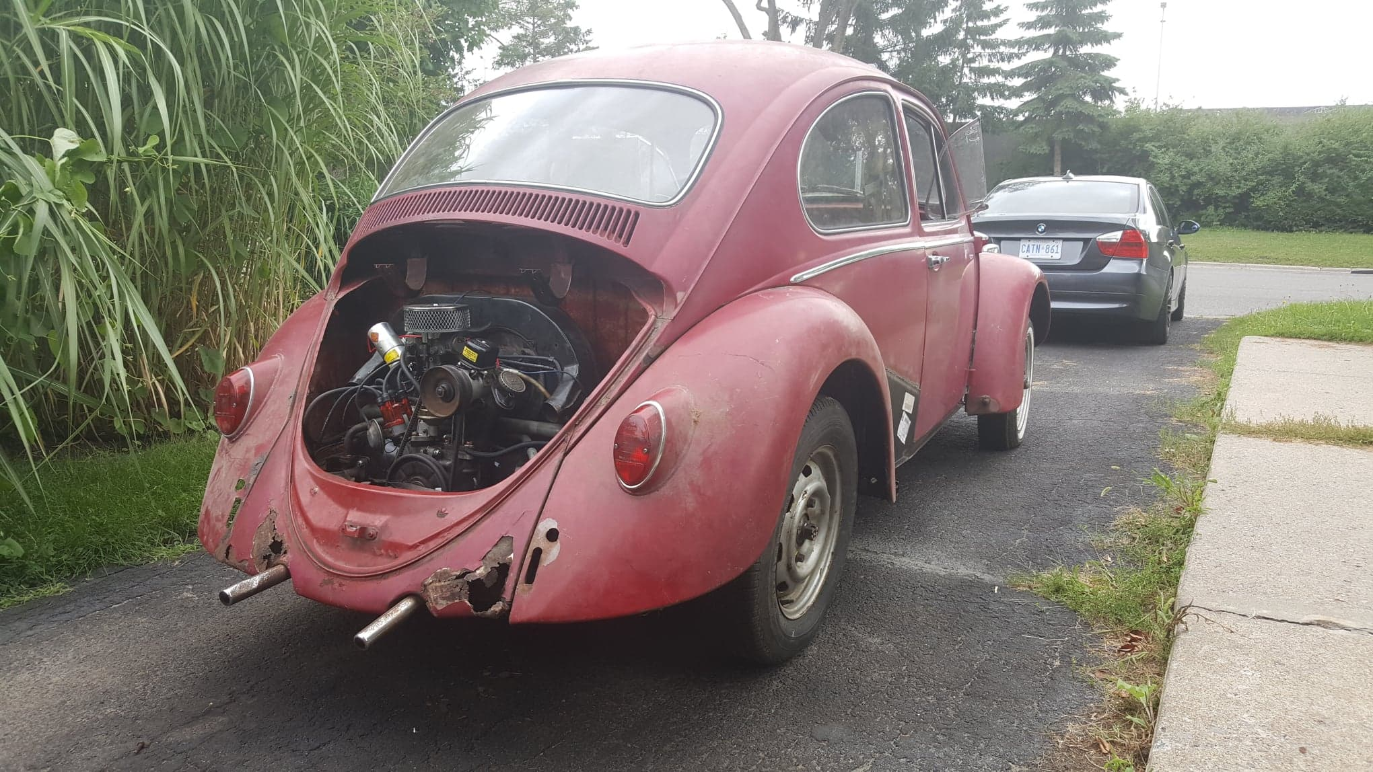
Andrei Juc
While not problem solving…

Slide 11
About Rogue Wave Software

Slide 12

“We help software eat the world faster”
Our Mission: We simplify complex software development, improve application quality and security, and shorten cycle times.
Founded in 1989
Global company, headquartered in Louisville, CO.
400 employees, 13 offices worldwide, 53 patents.
Our customers:
Automotive Software Development
Military and Aerospace
Medical Devices and Software
Embedded Software
Mobile and Communications
Game Development
Notes:
Honeywell

Slide 13




























Rogue Wave Customers
We ensure the most critical and complex aspects of the entire software lifecycle to support strategic business goals while minimizing risk.

Slide 14



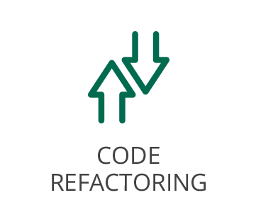

Continuous Static Code Analysis
Find defects early!
Web-based portal for reporting and analyzing results
Ability to be built into your Continuous Integration process
Very popular with mission critical industries
Allows customers to meet industry standards

Slide 15
About Docker

Slide 16
About Docker
An alternative to virtual machines!
Docker is an open source containerization software. It allows users to emulate operating systems inside of their own OS.
Docker takes advantage of resource isolation features of Linux in order to allow multiple independent OS-es to run on a single machine at once.

Slide 17
About Docker
Docker vs. virtual machines vs. chroot jails
From a top-level view, virtual machines, containers and chroot jails operate in the same way:
Both containers and VMs are isolated from the host OS and are unable to manipulate the host OS from inside-out.
Notes:
Honeywell

Slide 18
About Docker
Docker vs. virtual machines vs. chroot jails
Just like a VM (And unlike a chroot jail which only gets its own filesystem), a container has its own namespaces, control groups and filesystems.
This means actions performed inside containers are, by default, completely isolated from the host OS.

Slide 19
About Docker
Docker Benefits!☺
Images to share with testers and developers
Clean machine image for every build & test execution
Reliable, repeatable results
More scalability
Lightweight

Slide 20
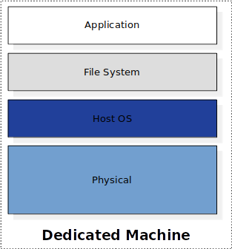
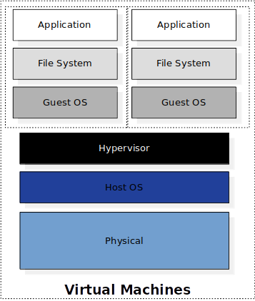
About Docker
Notes:
Honeywell

Slide 21
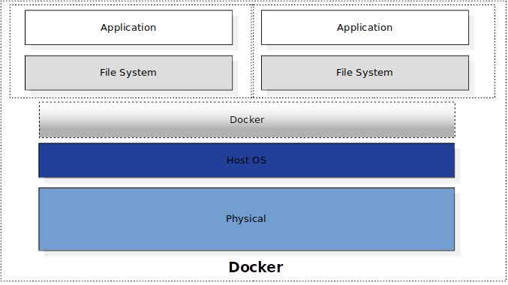
About Docker
Notes:
Honeywell

Slide 22
About Docker
Dockerfiles, Images and Containers
Image: In essence, a snapshot of the OS.
Made up of layers
Stored in registries, locally, or in tarballs
Dockerfile: Text file containing instructions for setting up environment
Each command creates a new layer
Container: A running image

Slide 23
About Docker
Dockerfiles
A Dockerfile is a text file containing instructions for building a docker image.
Instructs Docker on what image to pull down and the actions to perform on the image upon pulling it down.
Each line of instructions creates a unique layer in the final image.
This can optimize docker rebuild time; Layers are cached. Only modified layers are rebuilt.
Requires cached layers be in local storage
Notes:
Honeywell

Slide 24
About Docker
Example Dockerfile
FROM centos:centos7 <-- Base image to pull down
MAINTAINER Andrei Juc <-- Some information to store on the image
RUN yum -y update <-- Run update
RUN yum -y install libstdc++.i686 nano redhat-lsb-core.i686 <-- install some libraries
RUN adduser lmgrd <-- Add user lmgrd to docker image
EXPOSE 27000 <-- Expose TCP Port 27000 in the docker container that is to be.
Notes:
Honeywell

Slide 25
About Docker
Image storage and tracking
Docker images are stored in registries that are very similar to git repositories.
Image snapshots can be pushed and pulled from the registry using push/pull commands.
Once an image is pulled into your local system, the image state is saved on the local system and containers can be launched from the instance using run command.
Numerous containers can be launched from a single image on a single machine.
The docker engine will be responsible for allocating resources between all the different containers.
Users are also able to control resource allocation.
Notes:
Honeywell

Slide 26
About Docker
Containers
A running image (Container) will only have the top most layer as read-write. All other layers will be read-only.
Images can only grow in size. They will never shrink.
Container states can be captured and images created.
Containers can be run in interactive or detached mode.
Containers can be put into same docker pseudo-network.
Containers will only stay run until entrypoint process exits (PID 0).
By default, container data is deleted when containers are deleted.
More to come on this subject.
Notes:
Honeywell

Slide 27
About Docker
Building an image
# docker build -t <registry>/<image>:<tag> /path/to/DockerFile
# The -t tells docker to tag the resulting image for pushing into the registry/image:tag.
# This can be omitted if you do not intend to tag the image for pushing or you plan on doing it manually at a later date.
$ ls /space/docker_stuff/
Dockerfile
$ docker build /space/docker_stuff/
Sending build context to Docker daemone
...
Successfully built f3c2c3f85668
$ docker run [options] f3c2c3f85668 [command]
$ docker tag f3c2c3f85668 <registry>/<image>:<tag>
Notes:
Honeywell

Slide 28
The First Exercise

Slide 29
Our first Dockerfile
FROM ubuntu:18.04
#Install some dependencies
RUN apt-get update; apt-get install -y fortune cowsay
#Make a home directory and add a dummy user
RUN mkdir -p /home/dummy_user; useradd -d /home/dummy_user -s /bin/bash dummy_user;
#Make a workspace directory and make sure anyone can write to it
RUN mkdir -p /workspace; chmod -R 777 /workspace
#Switch to dummy user
USER dummy_user
ENV PATH=/usr/games/:$PATH
ENTRYPOINT ["bash", "-c"]
CMD ["fortune /usr/share/games/fortunes/literature | cowsay"]

Slide 30
Dockerfile interactions
Some useful docker build commands
# docker build --help
-c, --cpu-shares int …………. CPU shares (relative weight)
-f, --file string …………………. Name of the Dockerfile (Default is 'PATH/Dockerfile’)
-q, --quiet ………………………. Suppress the build output and print image ID on success
-t, --tag list …………………….. Name and optionally a tag in the 'name:tag' format
# cd /path/to/Dockerfile
# docker build -t cowsays:latest .

Slide 31
Container interactions (docker run)
Some useful docker run arguments
# docker run --help
--entrypoint string ……………… Overwrite the default ENTRYPOINT of the image
-e, --env list ………………………... Set environment variables
-c, --cpu-shares int …………….. CPU shares (relative weight)
--cpus decimal ………………. Number of CPUs
-d, --detach ………………………… Run container in background and print container ID
-i, --interactive ……………………. Keep STDIN open even if not attached
--name string ……………………… Assign a name to the container
-p, --publish list ………………….. Publish a container's port(s) to the host
-t, --tty ………………………………… Allocate a pseudo-TTY
-u, --user string …………………... Username or UID (format: <name|uid>[:<group|gid>])
-v, --volume list …………………… Bind mount a volume
# docker run cowsays
# docker run --name my_first_container -it --entrypoint /bin/bash cowsays

Slide 32
Container interactions (docker run)
Passing environment variables
-e <name>:<value>
# docker run –e EXECUTION_SUITE=sanity –e USER=$LOGNAME cowsays

Slide 33
Container interactions (docker run)
Mounting volumes
-v <source>:<destination>:<options>
# docker run –v /sharedlib:/space/testing/ cowsays

Slide 34
Image Interactions
Some useful image interaction commands
# docker commit --help
Usage: docker commit [OPTIONS] CONTAINER [REPOSITORY[:TAG]]
Create a new image from a container's changes
# docker tag --help
Usage: docker tag SOURCE_IMAGE[:TAG] TARGET_IMAGE[:TAG]
Create a tag TARGET_IMAGE that refers to SOURCE_IMAGE
# docker ps --help
Usage: docker ps [OPTIONS]
List containers
-a, --all ……………… Show all containers (default shows just running)
# docker images --help
Usage: docker images [OPTIONS] [REPOSITORY[:TAG]]
List images

Slide 35
Forgot something?
A little trick to save your bacon
Volumes, ports, security options and some others can only be set at creation time.
If you forgot something and want to save your work, exit, stop, commit and re-run with appropriate parameters.
# docker commit my_first_container my_first_snapshot
# docker run -it -p <port>:<port> -v /path/to/local/dir/:/path/to/docker/dir my_first_snapshot

Slide 36
Docker Volumes
Persistent Data!
Persistent data not available in Docker by default
Volumes can be used to maintain persistent data
Can be shared among multiple containers
Can store volumes remotely (cloud)
Volume does not increase the size of the container

Slide 37
Docker Volumes
Create a volume
# docker volume --help
Usage: docker volume COMMAND
Manage volumes
Commands:
create Create a volume
inspect Display detailed information on one or more volumes
ls List volumes
prune Remove all unused local volumes
rm Remove one or more volumes
# docker volume create first-vol

Slide 38
Docker Volumes
List volumes
# docker volume ls
local first-vol

Slide 39
Docker Volumes
Start container with a volume
# docker run -v first-vol:/storage cowsays
# docker run -v second-vol:/etc cowsays
Be sure you know what your command does!
Non-existent volume
Mount path with contents in it
Already available volume
Notes:
Don’t forget to mention! Non-existent volume -> Creates volume
Non-Existent volume and existent mount path -> contents of mount path copied into volume
Existent volume and existent mount path -> Overwrites contents of mount path with contents in volume

Slide 40
Docker Volumes
Remove a volume
# docker volume rm first-vol
# docker volume prune

Slide 41
Putting it all together!

Slide 42

Setting up an automation environment
Jenkins and Docker integration
# docker network create jenkins_network
# docker run --detach --network jenkins_network -p 8080:8080 -p 50000:50000 --name jenkins --hostname jenkins jenkins/jenkins:lts

Slide 43
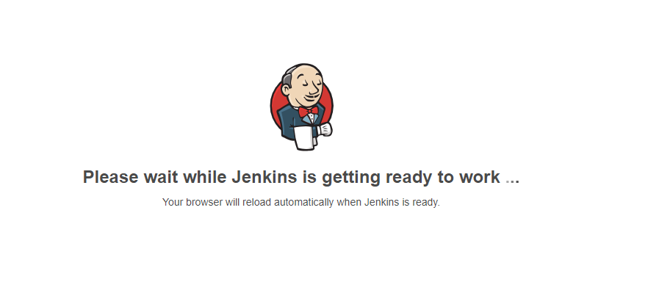
Jenkins getting ready
http://localhost:8080

Slide 44
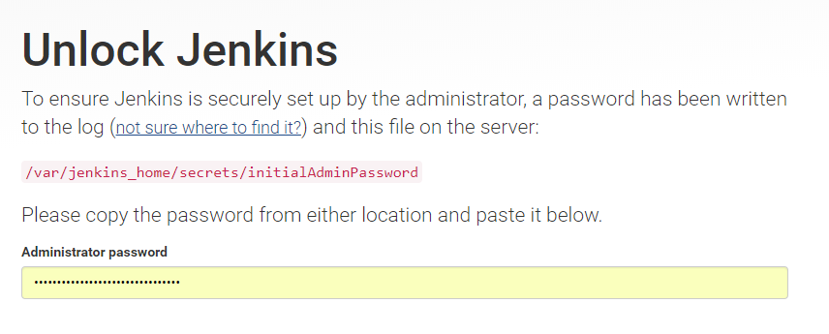
Unlocking Jenkins
# docker exec -it jenkins /bin/bash
jenkins@jenkins$ cat /var/jenkins_home/secrets/initialAdminPassword
w873985135lkqwflkkjqf28103

Slide 45
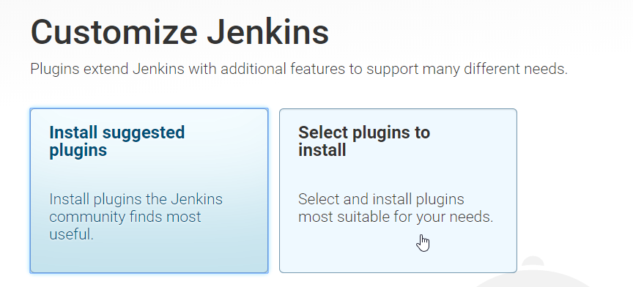
Customize Jenkins
Setting up a bare Jenkins

Slide 46
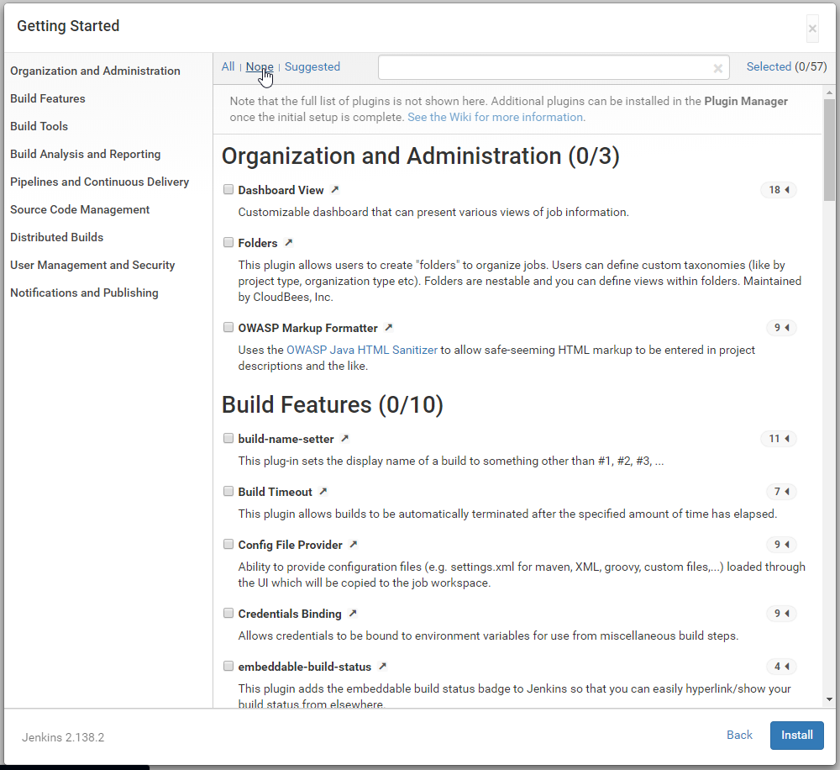
Customize Jenkins

Slide 47
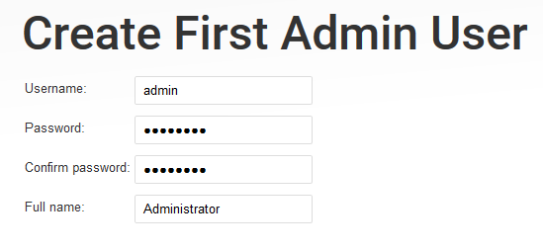
Creating our first Admin user

Slide 48
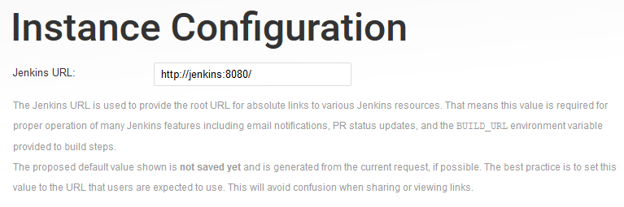
Instance configuration

Slide 49
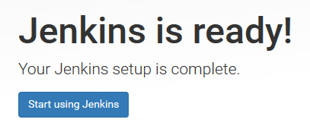
Jenkins is ready!
Start using Jenkins ☺

Slide 50
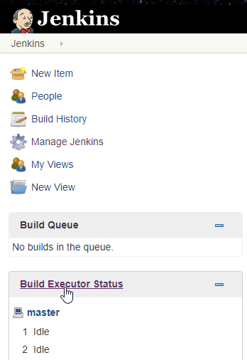
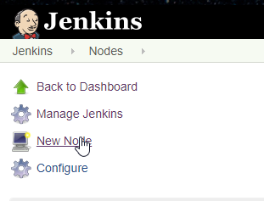
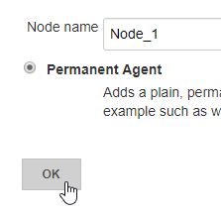
Adding a Jenkins node
A little bit of setup

Slide 52
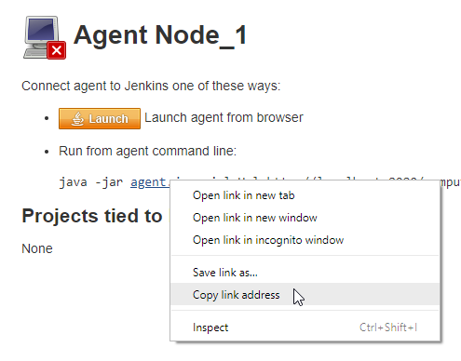

Slide 53
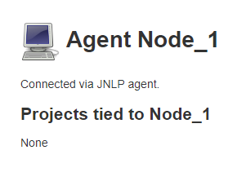
Adding a Jenkins node
# docker run -it --network jenkins_network --entrypoint /bin/bash --name node_1 jenkins/jenkins:lts
jenkins@node_1$ cd
jenkins@node_1$ mkdir jenkins
jenkins@node_1$ wget http://jenkins:8080/jnlpJars/agent.jar
jenkins@node_1$ java -jar agent.jar -jnlpUrl http://jenkins:8080/computer/Node1/slave-agent.jnlp -secret <secret_alpha_numerical_string> -workDir "/var/jenkins_home/jenkins"

Slide 54
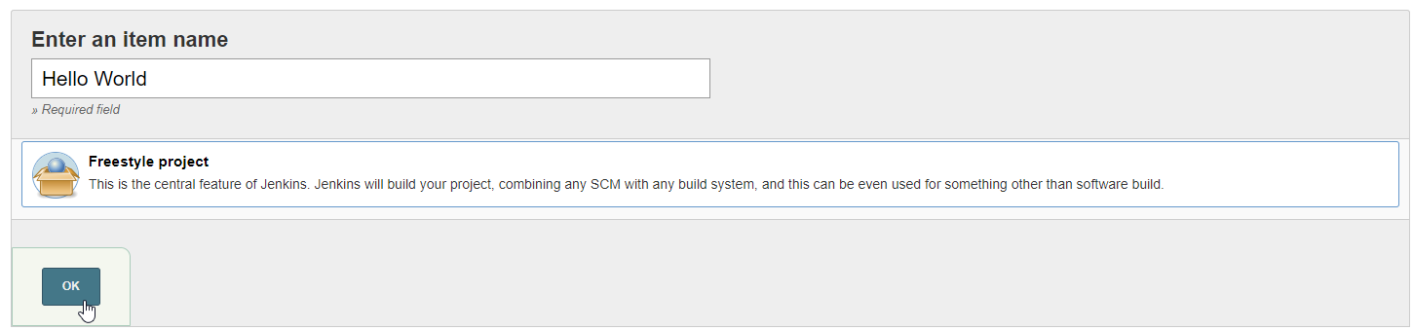
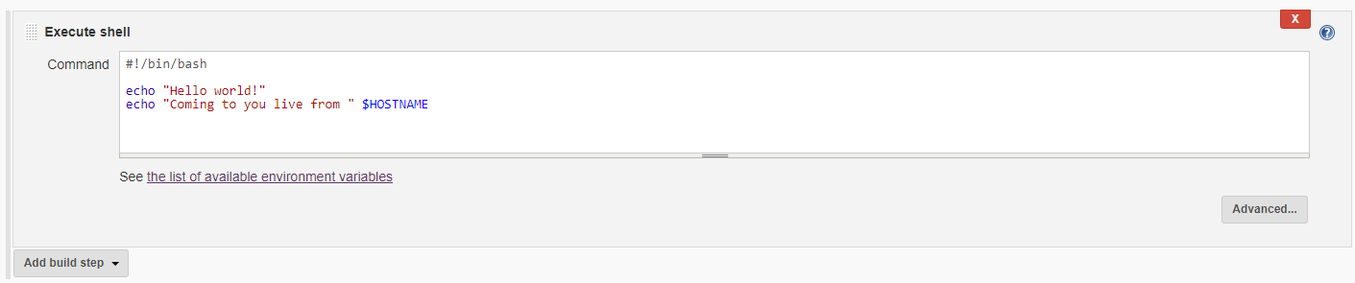
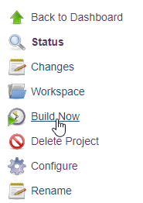
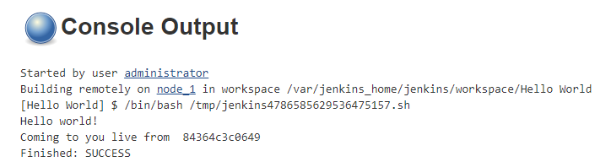
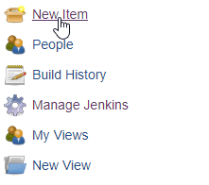
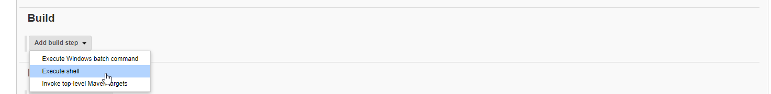
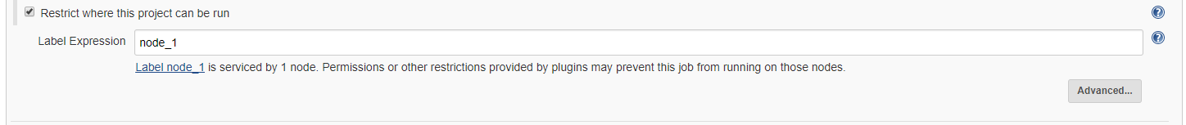

Slide 55
Automating image building
Using compounded docker commands
# docker build –t <registry>/<image>:<tag> .
# docker push <registry>/<image>:<tag>
# docker tag $(docker build –q .) <registry>/<image>:<tag>
# docker push <registry>/<image>:<tag>

Slide 56
Tips and Tricks

Slide 57
Docker inspect
A quick way to inspect your docker objects
docker inspect --help
Usage: docker inspect [OPTIONS] NAME|ID [NAME|ID...]
Return low-level information on Docker objects
Options:
-f, --format string ……………….. Format the output using the given Go template
-s, --size ……………………………… Display total file sizes if the type is container
--type string ……………………….. Return JSON for specified type

Slide 58
Docker cleanup
How to clean up your mess
Docker commands can be compounded for ease
Single command for easy cleanup
# docker stop $(docker ps –q)
# docker rm $(docker ps –qa)
# docker rmi $(docker images –q)
# docker volume rm $(docker volume ls –q)
# docker system prune --force

Slide 59
Docker registry
How to setup and maintain
# docker pull registry:v2
# docker run –d –restart=always –p 5000:5000 registry:v2
Maintenance is tricky and painful, do not rely on registry image storage. Always have dockerfiles!
Registries fill up and images are hard to delete.
Registries like to misbehave!

Slide 60
Docker host storage
Docker host storage location
Most of everything is stored in /var/lib/docker.
Access your volumes, your images, and your containers there.
Requires root access.
Can store your own volumes in /var/lib/docker/volumes/

Slide 61
Docker compose
More advanced image creation
Powerful way to dynamically create docker images.
Can be used in conjunction with Dockerfiles
.yaml format, used for dictating services, networks and volumes.

Slide 62
Copying files to and from containers
A good way to retrieve files
# docker cp --help
Usage: docker cp [OPTIONS] CONTAINER:SRC_PATH DEST_PATH|-
docker cp [OPTIONS] SRC_PATH|- CONTAINER:DEST_PATH
Copy files/folders between a container and the local filesystem
Options:
-a, --archive Archive mode (copy all uid/gid information)
-L, --follow-link Always follow symbol link in SRC_PATH

Slide 63
Closing Thoughts

Slide 64
Contact Us!
Scott Mills
scott.mills@roguewave.com
Twitter
LinkedIn
Andrei Juc
andrei.juc@roguewave.com
LinkedIn

